Slide 1
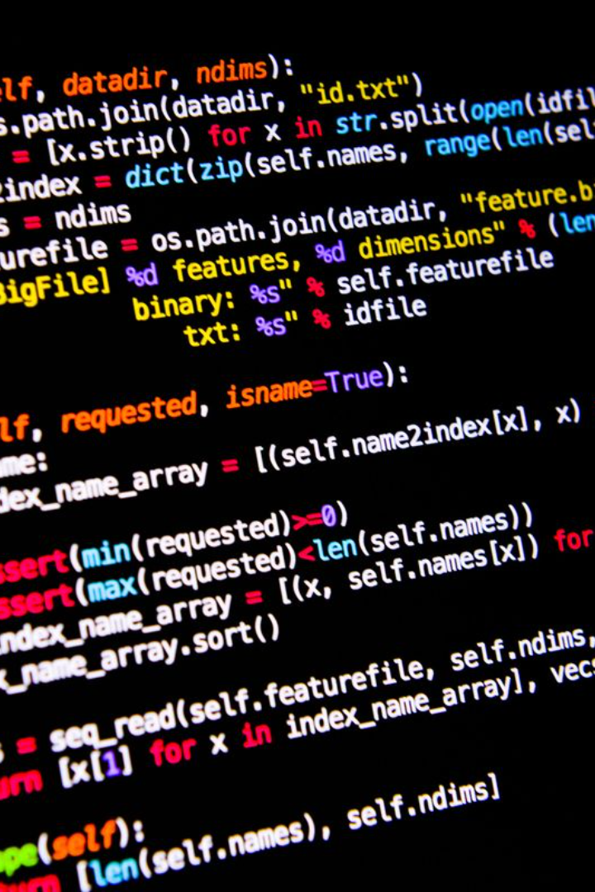

Creating Telegram Bot using Python
Welcome to the world of chatbots! In this presentation, we will explore how to build a Telegram bot using the Python programming language.

Slide 2
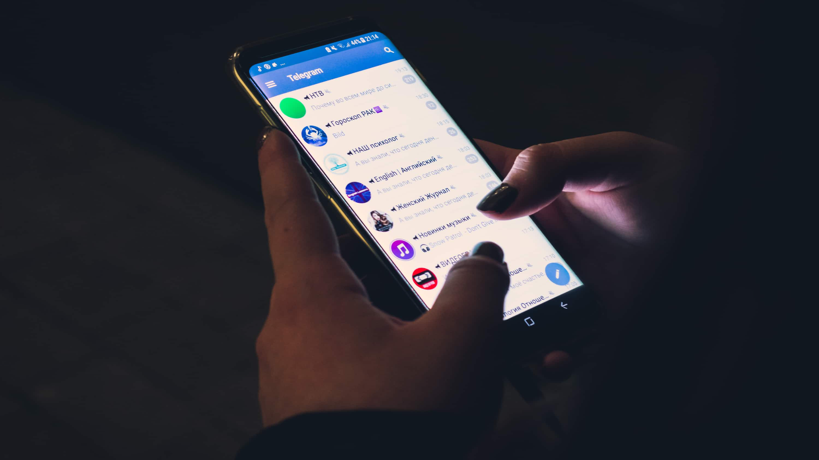
What is a Telegram Bot?
1
Interactive AI Assistants 🤖
2
Integrated in Telegram Messenger 📲
Telegram bots are AI-powered interactive assistants that can perform various tasks, like sending updates, providing information, and even playing games.
These bots are seamlessly integrated into the Telegram messaging app, allowing users to interact with them through messages.

Slide 3

Why Create a Telegram Bot?
Engage with Users
Automation and Efficiency
Expand your Reach
Telegram bots provide a great opportunity to engage with your audience, whether you want to automate customer support or deliver personalized content.
Telegram has a large user base with millions of active users. Creating a bot enables you to reach a wider audience and promote your services or products.
By creating a bot, you can automate repetitive tasks, save time, and improve efficiency in various domains, such as news delivery, weather updates, or productivity tools.

Slide 4

Setting up the project
1
Install Python and Required Libraries
2
Create a Telegram Bot Account
Next, create a bot account on Telegram. This will generate an API token that you can use to authenticate and interact with the Telegram API.
Get started by installing Python and the necessary libraries, such as python-telegram-bot, which provides a convenient interface for interacting with the Telegram Bot API.

Slide 5
Building the Bot Functionality
1
Connecting to the Telegram API
Establish a connection to the Telegram API using the bot's API token. This will enable your bot to send and receive messages.
Sending and Receiving Messages
2
Implement message handlers to receive and process incoming messages, and use the Telegram API to send responses back to users.
3
Implementing Commands and Handlers
Utilize the command and handle system provided by the python-telegram-bot library to handle user commands and trigger specific bot actions.

Slide 6
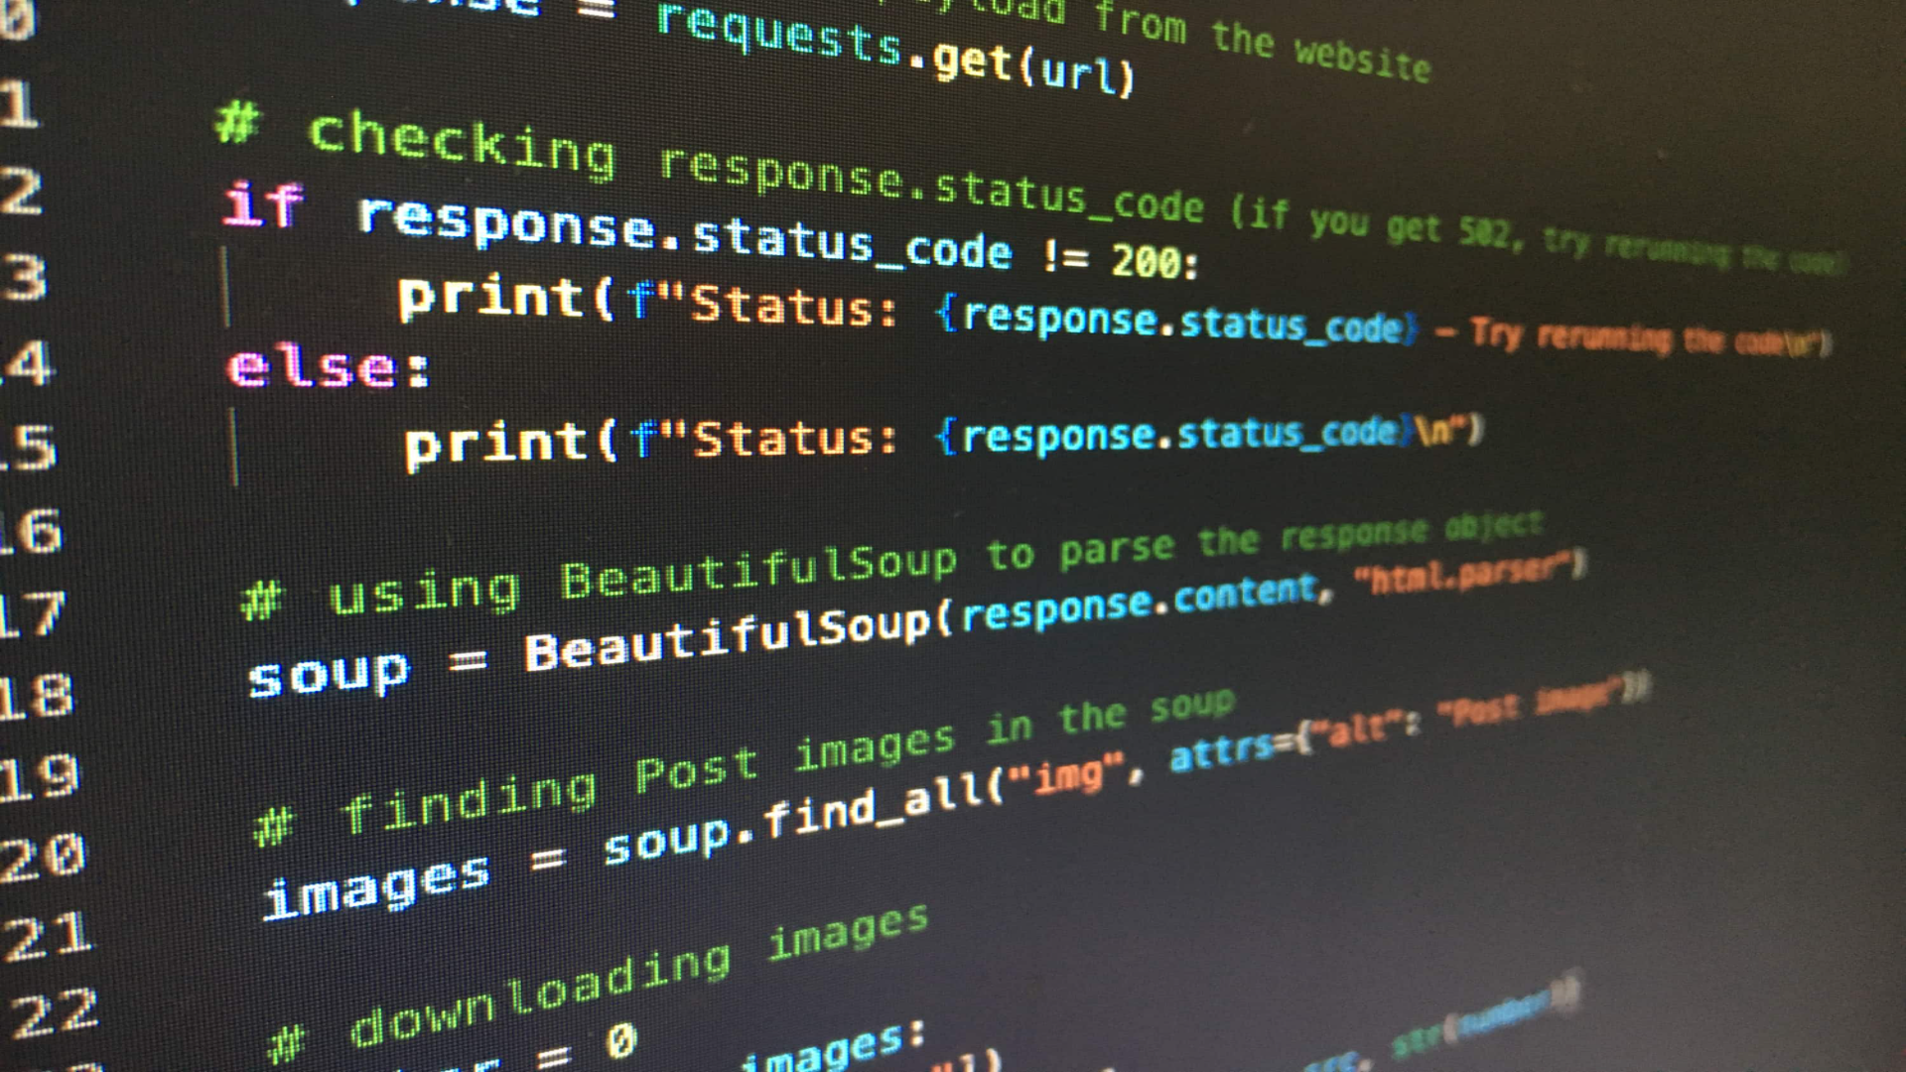
Code:
from telegram import Update
from telegram.ext import Updater, CommandHandler, CallbackContext
Replace 'YOUR_API_TOKEN' with the token you obtained from BotFather
TOKEN = 'YOUR_API_TOKEN'
def start(update: Update, context: CallbackContext) -> None:
update.message.reply_text('Hello! I am your Telegram Bot.')
def main() -> None:
# Create the Updater and pass it your bot's token
updater = Updater('YOUR_API_TOKEN')
# Get the dispatcher to register handlers
dp = updater.dispatcher
# Register the start command
dp.add_handler(CommandHandler("start", start))
# Start the Bot
updater.start_polling()
# Run the bot until you send a signal to stop
updater.idle()
if __name__ == '__main__':
main()

Slide 7
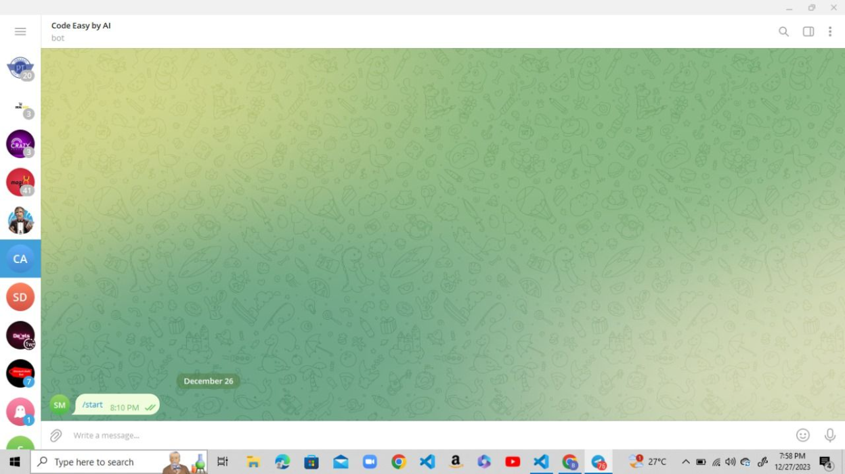
Output:

Slide 8

Conclusion
Endless Possibilities
Join the Bot Revolution
Creating a Telegram bot using Python opens up a world of possibilities for automation, interaction, and engagement. Let your creativity flourish and start building your own bot today!
With the increasing popularity of chatbots, mastering bot development can give you a competitive edge in the digital world. Embrace the bot revolution!

